Slide 1

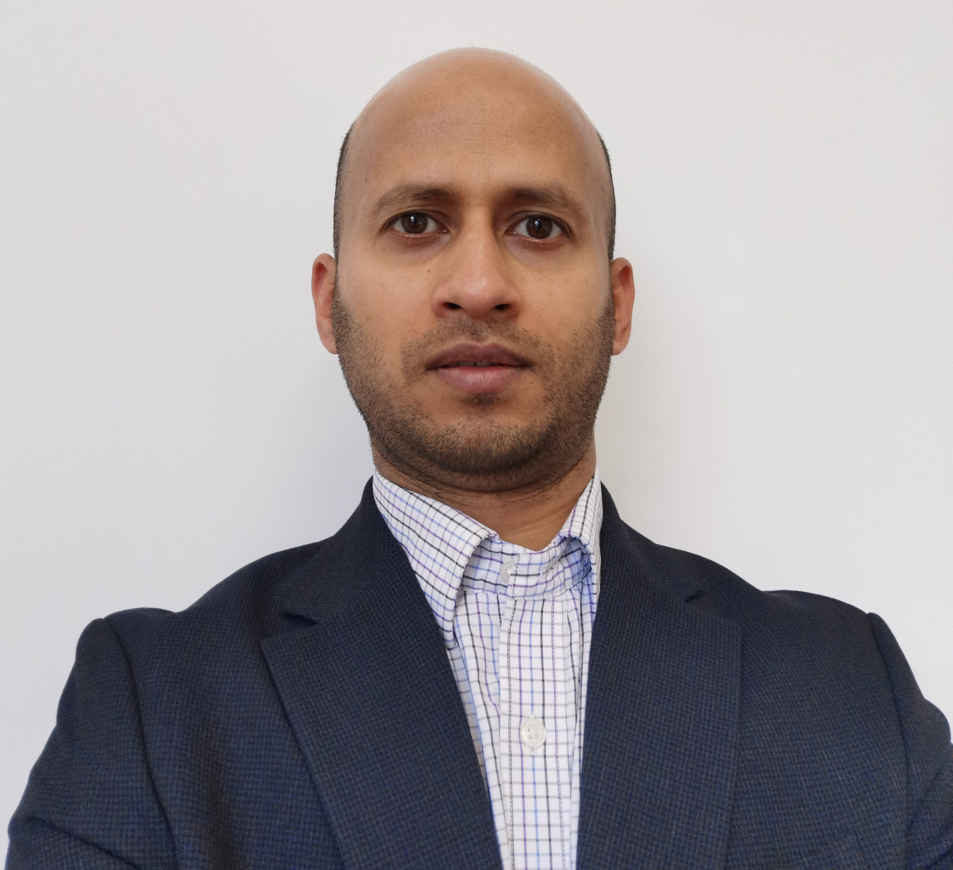
Acousto-ultrasonics for Next-Gen Structural Health Monitoring
ICMIAM2026
1-3 September 2026
A practical case-based workshop on Waves and AE based SHM
This workshop focuses on the wave propagation and acoustic emission (AE) techniques for advanced structural health assessment. Participants will explore both active and passive sensing approaches, understand the physics behind wave-based damage detection, and learn practical methods to implement next-generation SHM for civil, aerospace, and mechanical structures. The workshop emphasizes hands-on approaches, signal analysis, and real-world applications.
Workshop Content
Introduction to SHM
Wave Propagation Fundamentals and Acoustic Emission (AE) Basics
Signal processing & Advanced SHM strategies
Practical Implementation: Sensor placement guidelines, Noise and environmental effects, Data acquisition basics
Applications & Case Studies
Emerging Trends: AI/ML in SHM, Digital twins and predictive maintenance
Hands-on Session (Optional)
Signal acquisition demo & Simple damage detection example
Learning Objectives
By the end of the workshop, participants will be able to:
Understand wave propagation fundamentals in structures
Explain the principles of acoustic emission (AE)
Differentiate active (wave-based) and passive (AE) methods
Identify damage mechanisms using wave/AE techniques
Analyse signals to detect and locate defects
Apply sensor selection and placement strategies
Implement basic signal processing and feature extraction
Integrate methods for reliable real-time SHM
Explore applications across aerospace, civil, and mechanical systems
Presenters
Duration: 1-Hour
Mode: Interactive + Case-Based + Practical Calculation
Time: 11:00 – 12:00
Date: 3 September 2026
Venue: to be informed soon
Dr. Shirsendu Sikdar
School Computing and Engineering
Dr. Deba Datta Mandal
School Computing and Engineering
Workshop registration link
Contact email: icmiam2026@hud.ac.uk

